Slide 1

RENU BALAJI
AI & Product Portfolio
GitHub
LinkedIn
01. AI Operational Intelligence Tool
02. CraveCaster: AI Meal App
✉ 12balaji.renu@gmail.com

Slide 2
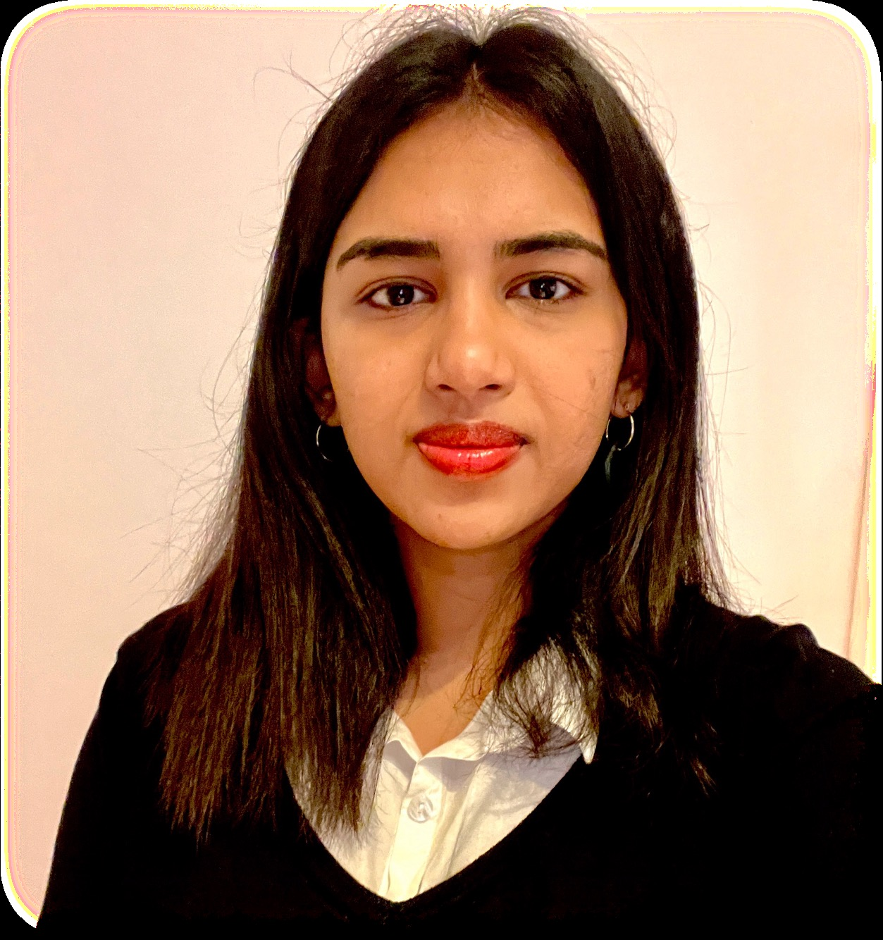
About Me
ABOUT ME:
I am a Product Operations & Management professional with 3+ years of experience across logistics, product, and data analytics. Passionate about AI integration workflows, agent building, and technical products, with hands-on experience in data-driven decision-making, KPI tracking, experimentation, and cross-functional product delivery.
I excel at translating complex operational data into actionable insights and building AI-powered tools that make a measurable impact. I bridge the gap between engineering, data, and business, turning ideas into shipped products. I have a genuine passion for AI. I stay current with the latest developments, continuously upskill, and actively look for opportunities to build and experiment with new tools and technologies.
Currently at Delivery Hero SE, building AI-powered operational intelligence and automated product support workflows.
📍 Berlin, Germany
🎓 MSc Molecular Biology (HU Berlin) · GPA 1.3
🏅 Gold Medalist B.Eng · GPA 9.7/10
📜 Data Analytics Diploma

Slide 3



01. AI Ops Intelligence Tool
01. AI Operational
Intelligence Tool
Building AI-powered operational oversight across 8 global markets
Objectives
Claude (Anthropic)
Built an end-to-end AI operational intelligence system connecting live BigQuery KPI data to a Claude-powered engine. The tool automatically identifies regional anomalies, maps issues to country level, surfaces root cause analyses with confidence scores, and auto-escalates to relevant Slack stakeholders, collecting responses back into a unified UI.
Demoed to Directors and Senior Directors at Delivery Hero. Currently in staged implementation.
BigQuery / SQL
Slack API
🚀 In Implementation: Delivery Hero SE

Slide 4
01. AI Ops Intelligence Tool
Key Questions
■ DATA
Source: Delivery Hero BigQuery
Markets: 8 live operational KPIs
Metrics: GMV, conversion, failure rates
Which regions are underperforming against KPI targets?
What secondary metrics are driving the anomaly?
■ TOOLS
Claude · BigQuery / SQL
Slack API · Google Workspace · Python
What is the root cause — with what confidence score?
Who needs to be alerted and what action is required?
■ SKILLS
Causal modelling · Anomaly detection
RCA generation · KPI dashboards
Slack workflow automation

Slide 5
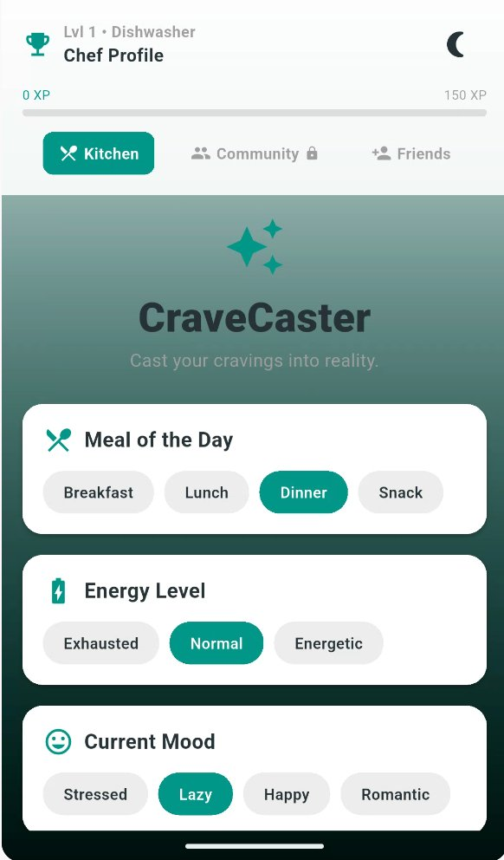
02. CraveCaster
02. CraveCaster
Cast your cravings into reality.
A personal Flutter app built with Claude and Gemini, hosted on Firebase Studio. CraveCaster takes your mood, energy level, dietary preferences, available ingredients and cuisine choice, then generates a personalised meal with a full nutritional breakdown.
Features a gamified XP levelling system, step-by-step cooking mode, AI photo verification of completed dishes, and friend challenge leaderboards. Built and used personally every day.
Objectives

Slide 6
02. CraveCaster
Key Questions
Mood & energy-aware meal suggestions
AI-powered food nutrition scoring
Step-by-step cooking mode
AI photo verification of dishes
XP levelling & friend challenges
■ APP FEATURES
What meal fits my mood, energy level and cravings right now?
Does this meal meet my nutrition goal with a full macro breakdown?
Flutter · Claude (Anthropic)
Gemini CLI · Firebase Studio
■ TOOLS & STACK
Did I actually cook the right dish? (AI photo verification)
How do I earn XP and compete with friends on cooking challenges?

Slide 7
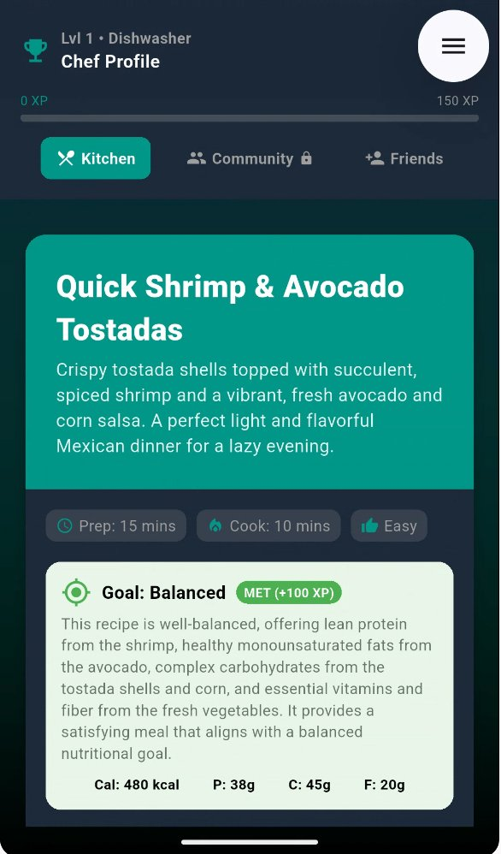
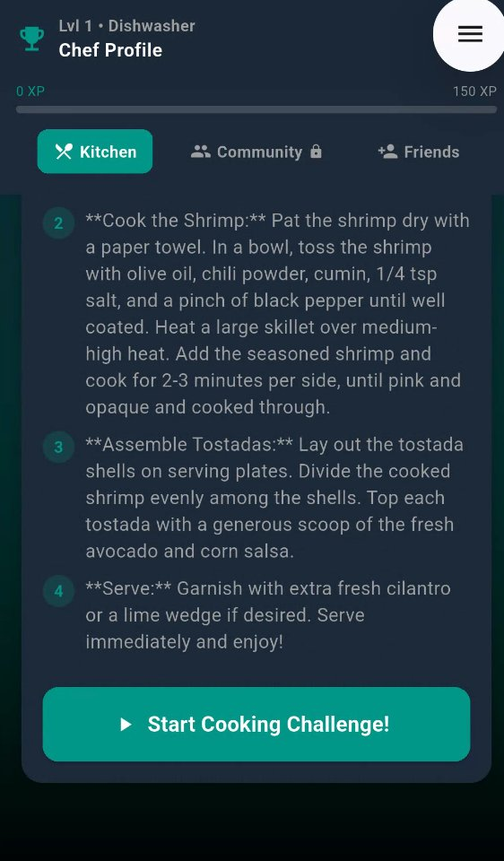
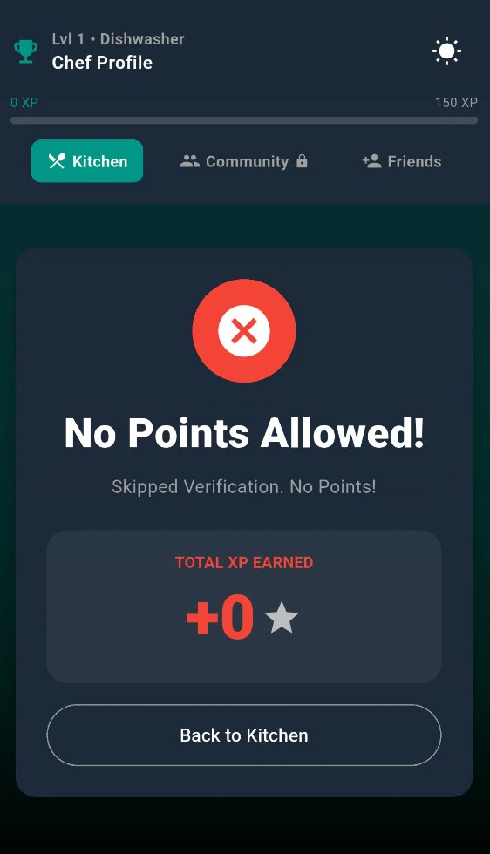
02. CraveCaster — The Experience
From Craving to Cooked: Gamified
Set Context
AI Suggests
Cook It
Verify & Level
Mood, energy,
diet, cuisine
& ingredients
Claude & Gemini
generate meal +
nutrition + XP
Step-by-step
cooking mode
guides you
Upload photo,
AI confirms dish.
Earn XP or zero!

Slide 8
Skills & Tech Stack
What I Build With
AI-Powered · Data-Driven · Shipped
AI & LLMs
Data & Analytics
Product & Build
· Claude (Anthropic)
· BigQuery / SQL
· Flutter / Firebase
· Gemini CLI
· Python
· Slack API
· ChatGPT Codex
· Tableau
· JIRA / Confluence
· Agentic Workflows
· Looker
· Product Roadmapping
· Prompt Engineering
· Causal Modelling
· KPI Frameworks
· Notebook LM
· A/B Experimentation
· Agile / Scrum

Slide 9
THANK YOU
RENU BALAJI
GitHub
LinkedIn
✉ 12balaji.renu@gmail.com

